Slide 1
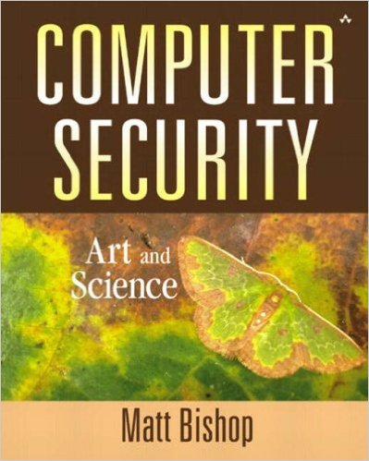
Computer and Network Security COMP 5370/637* Lecture #6 August 26, 2015
Tony Skjellum
skjellum@auburn.edu

Slide 2
Today’s Topics
Integrity
Privacy (Confidentiality)
Completeness (Subset of availability)
Cryptography

Slide 3
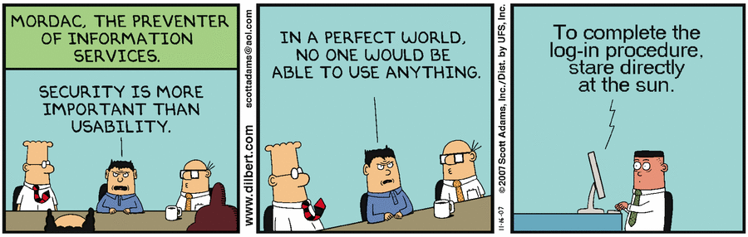
More Dilbert Security!
Opinions?
http://dilbert.com/search_results?terms=cyber+security

Slide 4
Integrity
Trustworthiness of data or resources
It includes correctness and trustworthiness
How to know data sent and received is not altered in between.
Trivial solution : Send it twice/thrice .. multiple times
What if it data received is differing each time it is received.
Expensive (!)
Alternate solution : “Checksums”

Slide 5
Integrity : Checksum
Checksum is a function of the data that is smaller than the data
An 8-bit checksum sums up the input data and keeps the bottom 8 bits (1 byte) as “checksum”
When data is altered, the checksum received ideally also changes indicating data received is modified
Not guaranteed to work if multiple errors occur
Unix has “chksum” utility

Slide 6
Checksum : Pros & Cons
Works great for single bit errors
Doesn’t help when data modifications have correlations involved
Additive checksum is used to protect data with the TCP/IP protocol

Slide 7
Hamming codes
Works on the concept of parity bits
Parity bits are added to data to detect and locate error / modifications in transmitted data

Slide 8
Hamming code : Example
Example :
Data to be transmitted is : 1001101
Parity bits are placed at powers of 2
Since we have 7 bits , parity bits are placed at 2^0 , 2^1, 2^2, 2^3
Bits are placed at 1,2,4,8 positions
How it looks : 100 r4 110 r3 1 r2 r1
How are these bits calculated?

Slide 9
Hamming code : Example (Contn’d)
First bit is calculated using all bits positions whose binary representation includes a 1 in the rightmost position.
Second bit is calculated using all the bit positions with a 1 in the second position and so on.
Set a parity bit to 1 if the total number of ones in the positions it checks is odd. Set a parity bit to 0 if the total number of ones in the positions it checks is even.

Slide 10
Hamming code : Example (Contn’d)
With that logic : r1 = 1, r2=0, r3=0, r4= 1
So, resulting data that is transmitted is : 10011100101
These parity bits are used for error detection and correction
Most precise with one bit errors
https://en.wikipedia.org/wiki/Hamming_code

Slide 11
Cyclic Redundancy Check (CRC), 1
Better checksum!
Good at detecting common errors caused by noise in transmission
Short, fixed-length binary sequence, known as the check value or CRC, for each block of data to be sent or stored and appends it to the data, forming a codeword.

Slide 12
Cyclic Redundancy Check (CRC), 2
Protects only against errors on communication channels but not against intentional alteration of data.
1 in 2^N chance of missing single bit error with N-bit CRC
High probability of catching N-bit burst errors
Computing CRCs must match the order of the bytes put on line to preserve burst property of codes
CRCs are used to protect Ethernet frames – frame check sequence – see https://en.wikipedia.org/wiki/Frame_check_sequence
https://en.wikipedia.org/wiki/Cyclic_redundancy_check

Slide 13
Privacy
Concealment of information and resources
Msg A
Msg B
Msg A
Clear text
Black box
Cipher text
Black box
Clear text
Encryption
Decryption

Slide 14
Cryptography
Two types
Black box (Algorithm) is secret ( eg: one time pads)
Algorithm is open, keys used are secret.
Zeroth principle of Cryptography: All strength of encryption lies in keys.

Slide 15
Cryptography
Substitution techniques
Caeser cipher
Plain text : a b c d e f
Cipher text: d e f g h i
Eg : Plain text: cab encrypted: fde
Total of 25 keys are possible (set of English alphabet; one less than # of letters)

Slide 16
Caeser cipher
Encyption algorithm:
C = E(k,p) = (p+k)mod 26
k: value in the range 1 to 25 p: plain text
Decryption algorithm:
p=D(k,C)= (C-k)mod 26
Brute Force cryptanalysis can break this cipher (e.g., try all keys)
https://en.wikipedia.org/wiki/Caesar_cipher

Slide 17
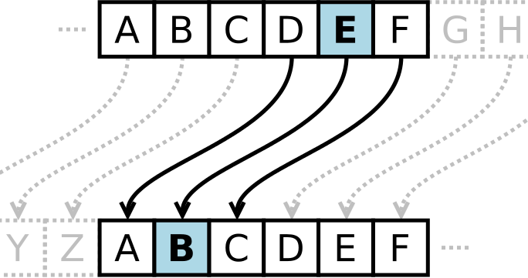
Caesar cipher with a shift of 3. Plaintext is at the top, Ciphertext is at the bottom
https://commons.wikimedia.org/wiki/File:Caesar_cipher_left_shift_of_3.svg#/media/File:Caesar_cipher_left_shift_of_3.svg

Slide 18
Huffman coding
Lossless data compression
It takes in sequence of characters and calculates the percent frequency of each symbol
Suppose sequence is aaaabbcd
a has 50%, b has 25%, c has 12.5%, d has 12.5%
build a huffman tree

Slide 19
Huffman tree
root 1.00
combine c&d yielding frequency of .25 and so on until frequency 1.00 is reached.
r’ : 0.50
a : 0.50
r’’:0.25
b:0.25
c: 0.125
d: 0.125

Slide 20
Huffman binary codes
To generate binary codes of each node in tree, traverse tree outputting a 0 every time you take a lefthand branch, and a 1 every time you take a righthand branch.
That gives a : 1, b: 01, c: 000, d:00.
Use these codes to represent the data that is to be exchanged on communication channels
https://en.wikipedia.org/wiki/Huffman_coding

Slide 21
Availability
Hash algorithms : Sha1, md5sum
Birthday attack

Slide 22
md5
message digest algorithm
cryptographic hash function
used for verification of data integrity
It is a 128 bit hash value
Considered “cryptographically broken”
Still widely for checksum purposes
SHA-2, SHA-3 better
We will discuss cryptographic hashes in greater detail later!
https://en.wikipedia.org/wiki/MD5

Slide 23
Sha1
Cryptographic hash function (160 bits)
hash value known as message digest is used.
message digest is presented in a hexadecimal format
Used in Digital Signatures
Currently being deprecated (cf, SHA-2, SHA-3)
https://en.wikipedia.org/wiki/SHA-1

Slide 24
Birthday attack
Collision vulnerability : Two documents have the same hash value
When there is possibility of collision vulnerability, the digital signatures made using the md5 hashes are susceptible to birthday attacks
If you can modify document A by just a little, to make document A’ with same hash, you can do very bad things (like forge a contract)
https://en.wikipedia.org/wiki/Birthday_attack

Slide 25
Additional References
https://en.wikipedia.org/wiki/Cyclic_redundancy_check
https://en.wikipedia.org/wiki/Checksum
http://users.cis.fiu.edu/~downeyt/cop3402/hamming.html
https://www.siggraph.org/education/materials/HyperGraph/video/mpeg/mpegfaq/huffman_tutorial.html

Slide 26
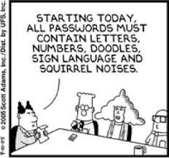
BACKUP

